Slide 1


GPT-Bakery
Developed by GPT-369
Instructor:
Ms. Nguyễn Minh Huy
Ms. Mai Anh Tuấn
Ms. Hồ Tuấn Thanh

Slide 2
Members of team
Mạch Cảnh Toàn – 19127584
Huỳnh Hoàng Giang – 19127383
Lê Hoàng Phúc - 19127059

Slide 3


Project introduction

Slide 4
Problem statement
Problem: The severity of the Covid 19 which causes problems in-store selling.
Affects: Customers, stakeholders, managers, bakery workers
Impact: Customers lost, low profit
Solution: Online store

Slide 5
Product Position Statement
For: customers which includes children, office workers, elderly, fit for many types of customer
Who: Logging, add to cart, payment, view many types of cakes
The GPT-Bakery: is an application
That: Enables online shopping for cakes, cookies and view recipes
Unlike: The current store selling system

Slide 6

Project management

Slide 7
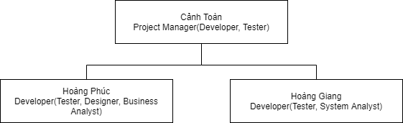
Organizational Structure

Slide 8

Software requirements

Slide 9
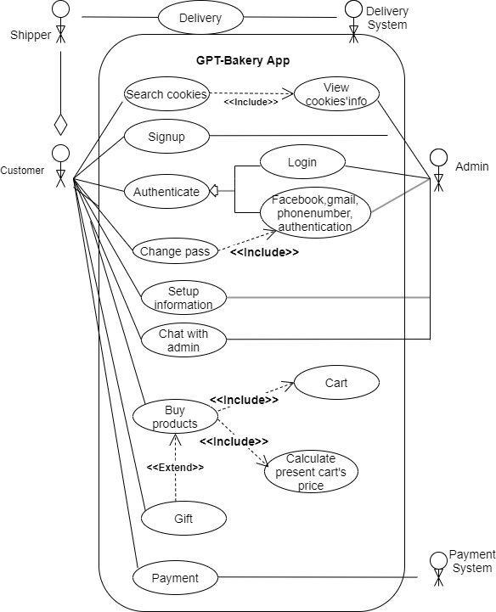
Use-case model

Slide 10
Non-fuctional requirements
Performance:
The total system down time should not exceed 20 minutes
The recovery time should not be less than 3 minutes
Usability:
Effort required to learn, use.
Provide input
Interpret results of a program
Efficiency: minimal use of resources (memory, processor, disk, network…)
Reliability: of computations, precision
Security
Robustness: in the presence of faults, stress, invalid inputs…
Adaptability: to other environments or problems
Scalability: for large number of users or quantities of data
Cost: total cost of ownership (TCO) for acquisition, installation, use, disposal

Slide 11

Analyst and Design

Slide 12
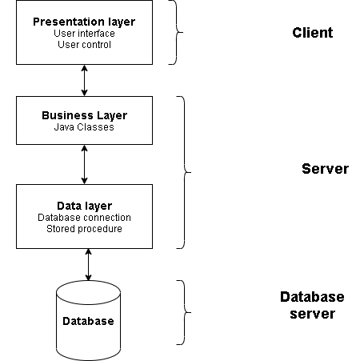
Logical view

Slide 13
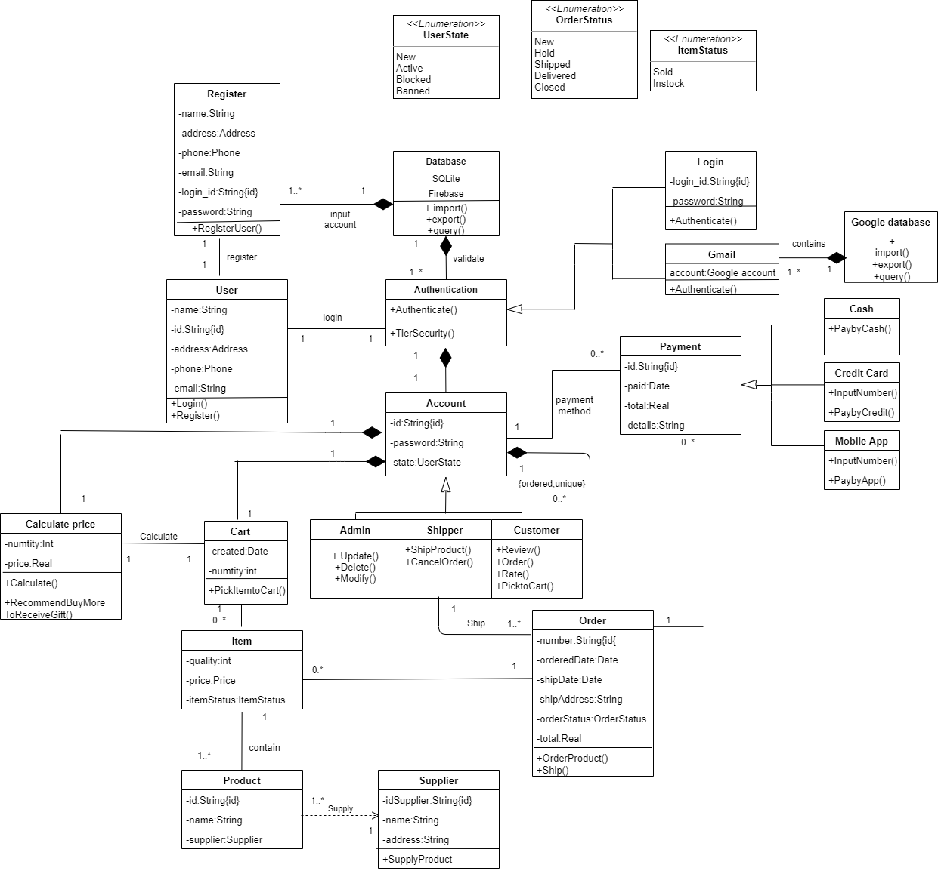
Component

Slide 14
Component
01
02
03
Login and register
Product and Cart
Order and Payment

Slide 15

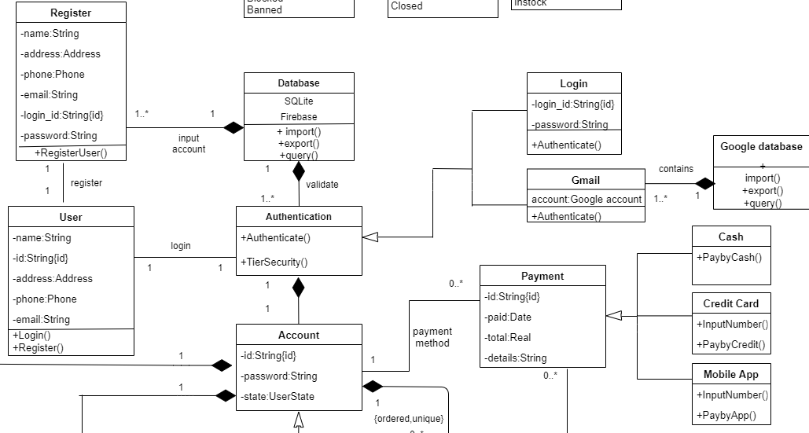
Login and register

Slide 16
Login and register
Class User: This class has function to Login and Register to app
Class Database: Include SQLite and Firebase to store data. In this class has function to insert, delete, query data. This class has relationship composition with class Register and Authentication
Class Authentication: This class has function authentication when user log in.It’s has relationship composition to class Account
Class GmailAuthentication: This class has function log in by google account. It’s generalized by class AuthenticationScalability: for large number of users or quantities of data
Class GoogleDatabase(Firebase): In this class has function to insert,delete,query data. This class has relationship composition with class Gmail authentication
Class Account: This class is create by user when login successful to app. It’s has function to using features of app. It’s has composition relationship to class CalculatePrice,Cart,Order and association relationship to class Payment

Slide 17

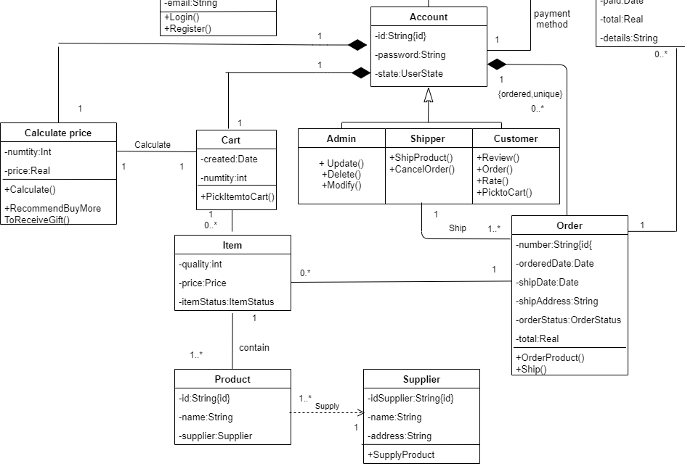
Product and Cart

Slide 18
Product and Cart
Class Admin: This class has function login by role is “Admin” and update,delete,modify product. It’s generalized by class Account
Class Customer: This class has function login by role is “Customer” and review,order,pick to cart,rate product. It’s generalized by class Account
Class Shipper: This class has function login by role is “Shipper” and Ship and Cancel order product. It’s generalized by class Account
Class Order: This class has function to order product from account. This class has relationship association to Item,Shipper,Payment class
Class Cart: This class has function to pick product to cart
Class Calculate: This class has function to calculate total price of all product that account pick to cart and order
Class Item: This class consist information item that could get by order and cart
Class Product: This class is contained by class item
Class Supplier: This class is supply product from supplier

Slide 19

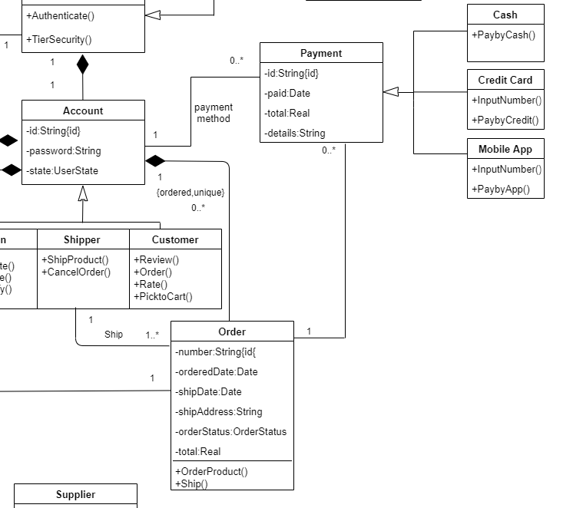
Order and payment

Slide 20
Order and payment
Class Payment: This class has function to pay money for product
Class Cash: This class generalized from class Payment, has function to pay money by cash
Class Credit card: This class generalized from class Payment, has function to pay money by credit card
Class Mobile App: This class generalized from class Payment, has function to pay money by app

Slide 21
Technologies
Android studio: the official Integrated Development Environment (IDE) for Android app development
SQL lite: Free Relational Database Management System
Firebase: a platform developed by Google for creating mobile and web applications

Slide 22

Software testing

Slide 23
Test plan
Target test items:
Bill ordered
Cart
Update profile
Checkout
Login
Forgot password
Reset password

Slide 24
Test environments
Environment needs:
The listing below identifies those items (use cases, functional requirements, non-functional requirements) that have been identified as targets for testing. This list represents what will be tested.
Hardware Requirements: List below shows the minimum configuration for running the application and testing:
Mobile environment: Android 4.0(suitable for most of mobile phone)
Memory: 512Mb RAM
Storage: 50Mb available space
Network: 3G, 4G, 5G or Wifi

Slide 25
Test environments
The following base software elements are required in the test environment for this Test Plan.
Mobile Name | Purpose | Android Version | Type and Other Notes
OPPO F7 | Testing application and check UI, bug | 10 | None
Samsung G7 | Testing application and check UI, bug | 8 | None
OPPO F9 | Testing application and check UI, bug | 10 | None
Pixel_3a_API_30_x86 | Testing application and check UI, bug | 4 | Android studio’s virtual system
Huawei | Testing application and check UI, bug | 7 | None

Slide 26
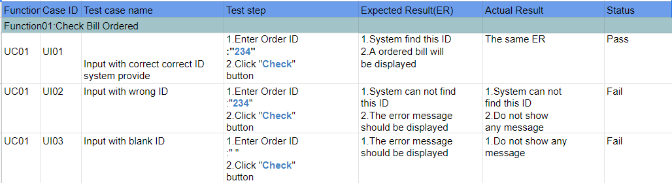
Test results

Slide 27
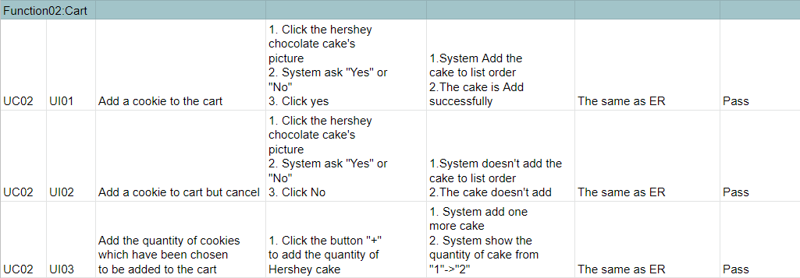
Test results

Slide 28
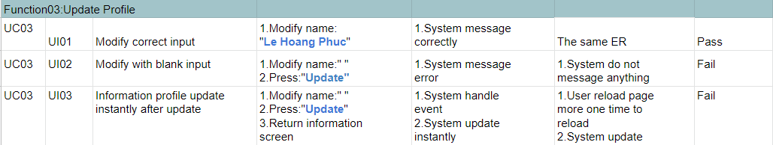
Test results
24 test case was tested:
14 test case failed
10 test case passed
At the moment, 11 test case are fixed (closed)

Slide 29

Thanks!

